Slide 1

PIZZA SALES ANALYSIS USING SQL

Slide 2

ABOUT ME AND MY PROJECT
I am Anup Kumar Gupta and in this presentation I will try to show some useful insight from pizza sales dataset using my sql knowledge .

Slide 3


Pizzas table contains attributes
1. pizza_id
2. pizza_type_id
3. size
4. price
BORCELLE
RESTAURANT
ABOUT DATASET
Dataset consists of 4 tables name
1.order_details
2.orders
3.pizza_types
4.pizzzas
Order_details table contains attributes
1.order_details_id
2. order_id
3. pizza_id
4.quantity
Orders table contain attributes
1.order_id
2. date
3. time
Pizza_types table contains attributes
1.pizza_type_id
2. name
3. category
4.ingredients

Slide 4

ARE YOU READY FOR THE QUESTION THAT WE HAVE TAKEN

Slide 5

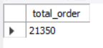
1. RETRIEVE THE TOTAL NUMBER OF ORDERS PLACED.
select count(*) as total_order from orders;

Slide 6

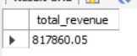
2. CALCULATE THE TOTAL REVENUE GENERATED FROM PIZZA SALES.
SELECT
ROUND(SUM((od.quantity * p.price)), 2) AS total_revenue
FROM
pizzas p
JOIN
order_details od ON od.pizza_id = p.pizza_id;

Slide 7


3. IDENTIFY THE HIGHEST-PRICED PIZZA.
SELECT
pt.name, MAX(p.price) AS highest_price
FROM
pizzas p
JOIN
pizza_types pt ON p.pizza_type_id = pt.pizza_type_id;

Slide 8
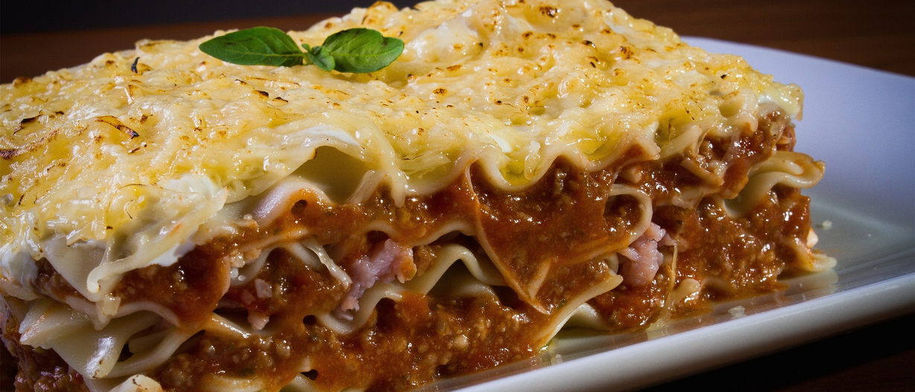
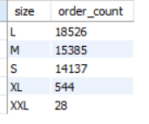
4. IDENTIFY THE MOST COMMON PIZZA SIZE ORDERED.
select p.size, count(od.order_details_id) as order_count
from pizzas p
join order_details od
on p.pizza_id = od.pizza_id
group by p.size
order by order_count desc;

Slide 9

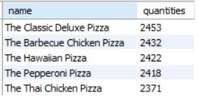
5. LIST THE TOP 5 MOST ORDERED PIZZA TYPES ALONG WITH THEIR QUANTITIES.
SELECT
pt.name, SUM(od.quantity) AS quantities
FROM
pizza_types pt
JOIN
pizzas p ON p.pizza_type_id = pt.pizza_type_id
JOIN
order_details od ON p.pizza_id = od.pizza_id
GROUP BY pt.name
ORDER BY quantities DESC
LIMIT 5;

Slide 10

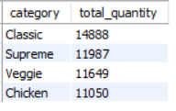
6. JOIN THE NECESSARY TABLES TO FIND THE TOTAL QUANTITY OF EACH PIZZA CATEGORY ORDERED.
SELECT
pt.category, SUM(od.quantity) AS total_quantity
FROM
pizza_types pt
JOIN
pizzas p ON pt.pizza_type_id = p.pizza_type_id
JOIN
order_details od ON p.pizza_id = od.pizza_id
GROUP BY pt.category
ORDER BY total_quantity DESC;

Slide 11
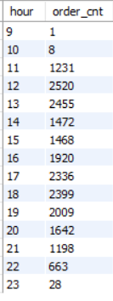

7. DETERMINE THE DISTRIBUTION OF ORDERS BY HOUR OF THE DAY.
SELECT
HOUR(o.order_time) AS hour, COUNT(o.order_id) AS order_cnt
FROM
orders o
GROUP BY hour
ORDER BY hour;

Slide 12

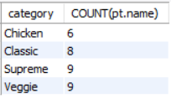
8. JOIN RELEVANT TABLES TO FIND THE CATEGORY-WISE DISTRIBUTION OF PIZZAS.
SELECT
pt.category, COUNT(pt.name)
FROM
pizza_types pt
GROUP BY pt.category;

Slide 13

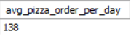
9. GROUP THE ORDERS BY DATE AND CALCULATE THE AVERAGE NUMBER OF PIZZAS ORDERED PER DAY.
SELECT
ROUND(AVG(quantity), 0) as avg_pizza_order_per_day
FROM
(SELECT
order_date, SUM(od.quantity) AS quantity
FROM
orders o
JOIN order_details od ON od.order_id = o.order_id
GROUP BY order_date) AS ord_quantity;

Slide 14




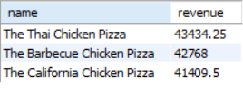
10. DETERMINE THE TOP 3 MOST ORDERED PIZZA TYPES BASED ON REVENUE.
select pt.name, sum(p.price * od.quantity) as revenue from pizza_types pt
join pizzas p on p.pizza_type_id = pt.pizza_type_id
join order_details od on od.pizza_id = p.pizza_id
group by pt.name
order by revenue desc limit 3;

Slide 15

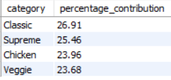
11.CALCULATE THE PERCENTAGE CONTRIBUTION OF EACH PIZZA TYPE TO TOTAL REVENUE.
WITH CTE AS (
select pt.category , sum(p.price * od.quantity) as revenue from pizza_types pt
join pizzas p on p.pizza_type_id = pt.pizza_type_id
join order_details od on od.pizza_id = p.pizza_id
group by pt.category order by revenue desc)
SELECT CATEGORY, ROUND((REVENUE/TOTAL_REVENUE) * 100,2) AS PERCENTAGE_CONTRIBUTION FROM
(SELECT CATEGORY , REVENUE, SUM(REVENUE) OVER() AS TOTAL_REVENUE FROM CTE
GROUP BY CATEGORY)AS PERCENTAGE_REVENUE;

Slide 16
12.Analyze the cumulative revenue generated over time.
with cte as(
select o.order_date, sum(p.price* od.quantity) as revenue
from orders o join order_details od on od.order_id = o.order_id
join pizzas p on p.pizza_id = od.pizza_id
group by order_date)
select order_date, round(sum(revenue) over(order by order_date),2)as cumulative_revenue from cte;

Slide 17

13. DETERMINE THE TOP 3 MOST ORDERED PIZZA TYPES BASED ON REVENUE FOR EACH PIZZA CATEGORY.
with cte as(
select pt.name, pt.category, sum(p.price * od.quantity) as revenue_of_each_pizza_type from pizza_types pt
join pizzas p on p.pizza_type_id = pt.pizza_type_id
join order_details od on od.pizza_id = p.pizza_id
group by pt.name
order by revenue_of_each_pizza_type)
select name, category, revenue_of_each_pizza_type ,ranking from (
select name, category,revenue_of_each_pizza_type,
rank() over(partition by category order by revenue_of_each_pizza_type desc)as ranking from cte)
as revenue_table
where ranking <=3;ty

Slide 18
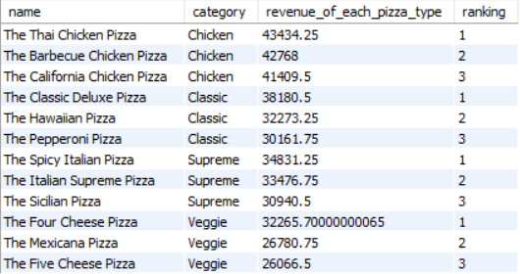

Slide 19

THANK YOU

